Slide 1

CYD & JULIE
By
Bridget Gibson

Slide 2
Cyd & Julie
Logline: Amid the chaos of the Blitzkrieg of World War II, a scared but determined cat must race against time find her beloved human before they’re torn apart forever.
IT’S HOMEWARD BOUND MEETS WINNIE THE POOH…..SET IN WORLD WAR II.

Slide 3
SYNOPSIS
During the Blitzkrieg of WWII, Nurse Julie Ward keeps her beloved scaredy cat, Cyd, close with her, even taking her to the hospital. While Julie works, Cyd snuggles patients in the Recovery Room. After staying late one night, the duo is caught in a bombing. Julie is knocked unconscious and Cyd is accidentally carried out of London on the roof of an ambulance. Hopelessly lost in the countryside, Cyd befriends a kindly Owl (Owleanor) and a devilish Fox (Phoebe) who agree to help her get back to London. The trio combine powers to combat the dangers of the countryside including a vengeful farmer and his dog. Julie, wounded and in the hospital, is heartbroken to learn Cyd was lost in the city during the bombing. She sneaks her way past hospital personnel to scour the city for Cyd. In the countryside, the stakes are raised for Cyd when the vengeful farmer finally catches up to the trio. Will Julie and Cyd find each other before they are separated forever?

Slide 4
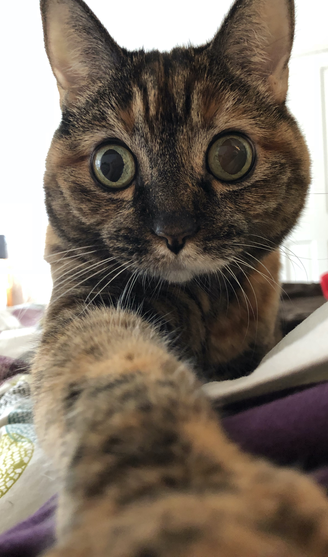
Cyd Ward
Born on a snowy morning in a garden, Cyd was taken to a pet shop in London at just a few weeks old. It was here that she first saw and was adopted by Nurse Julie Ward. Eating salmon and snuggling with Julie are Cyd’s favorite activities. Cyd is a stereotypical “scaredy-cat” but braves venturing out as long as she is with Julie. Being separated from Julie turns Cyd’s whole world upside down and knowing Julie is hurt is more than Cyd can take.
Possible voices: Jessica Chastain, Emma Watson, Saoirse Ronan

Slide 5
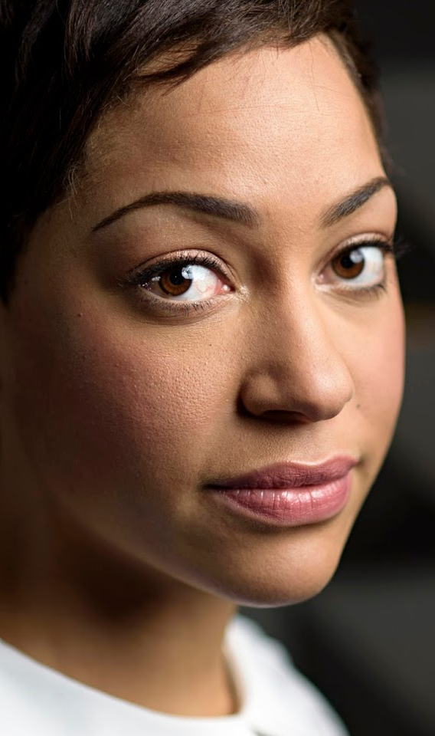
Julie Ward
Emigrating from Jamaica to the U.K. was not the adventure Nurse Julie Ward thought it would be. London was cold and lonely. And a World War broke out. But finding that kitten in a pet shop changed everything. In Cyd, Julie found the companionship she missed and the best friend she’s ever had. Taking Cyd everywhere was not only for safety during a war but also helped Julie come out of her shell in a foreign land. She had always promised nothing would happen to Cyd and she will do anything to fulfill that promise.
Possible voices: Cush Jumbo, Naomie Harris, Thandie Newton

Slide 6
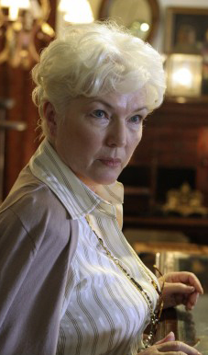
Mabel Mackintosh
This World War isn’t Nurse Mabel Mackintosh’s first rodeo. When it comes to war and nursing, Mabel has seen it all and done it all. Mabel loves three things: her nurses (including Cyd), Scotland and golf. For her nurses, Mabel is the epitome of “ride or die”.
Possible voices: Fionnula Flanagan, Emma Thompson, Miriam Margolyes

Slide 7
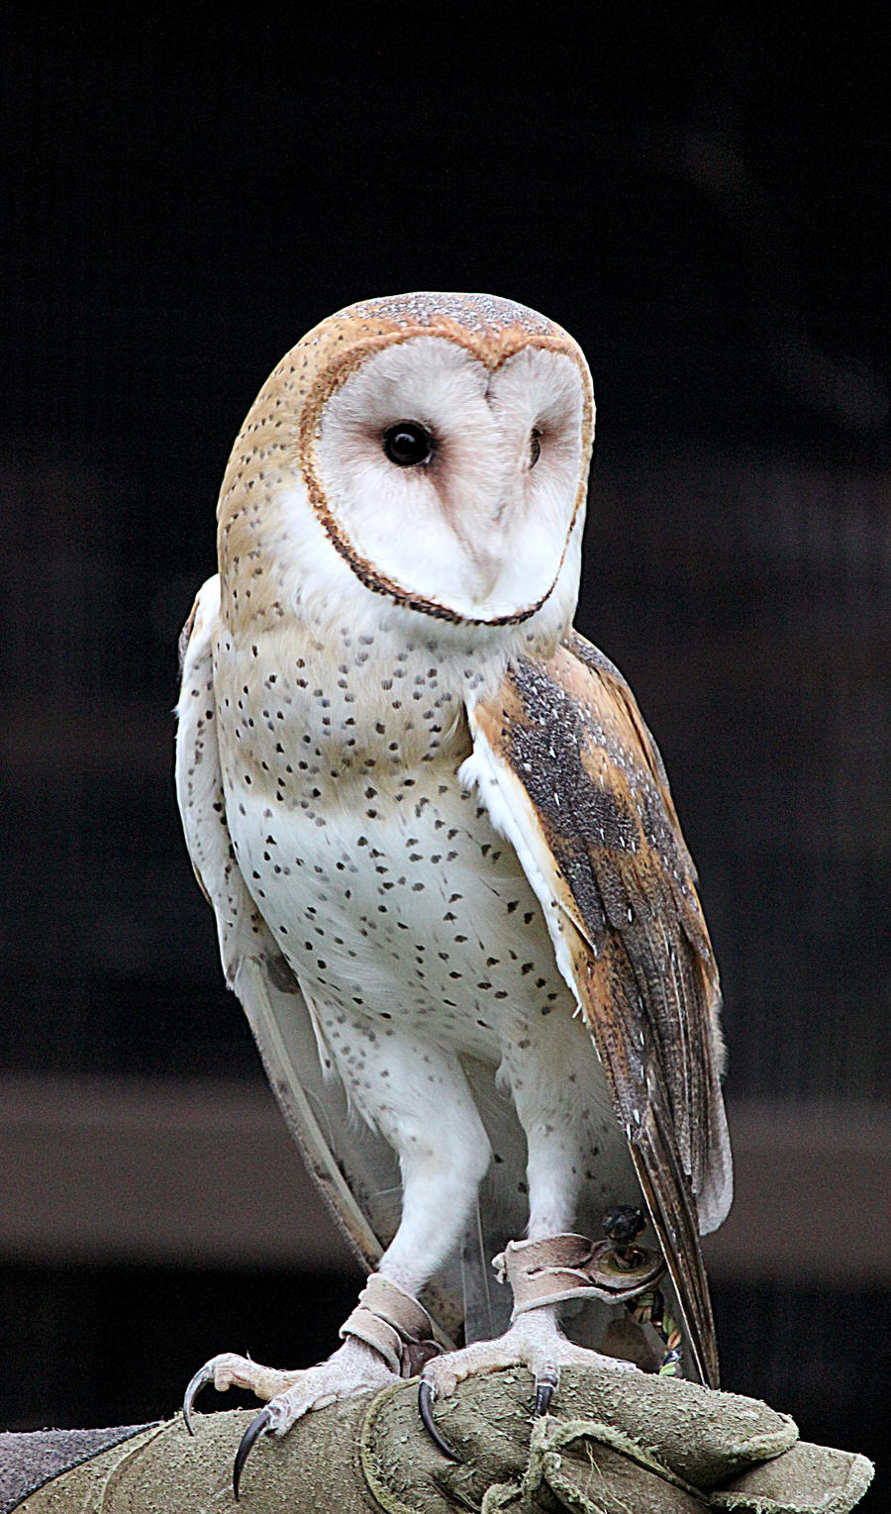
Owleanor
Owleanor the Barn Owl is a dichotomy: graceful, elegant and kind-hearted while also more than willing to attack, eviscerate and maim to keep her friends safe. With her ability to fly away, she could be miles away from danger in a matter of minutes. But leaving would mean abandoning her best friend, Phoebe, and she would rather die than do that.
Possible voices: Sophie Okonedo, Emma Thompson, Kate Winslet

Slide 8
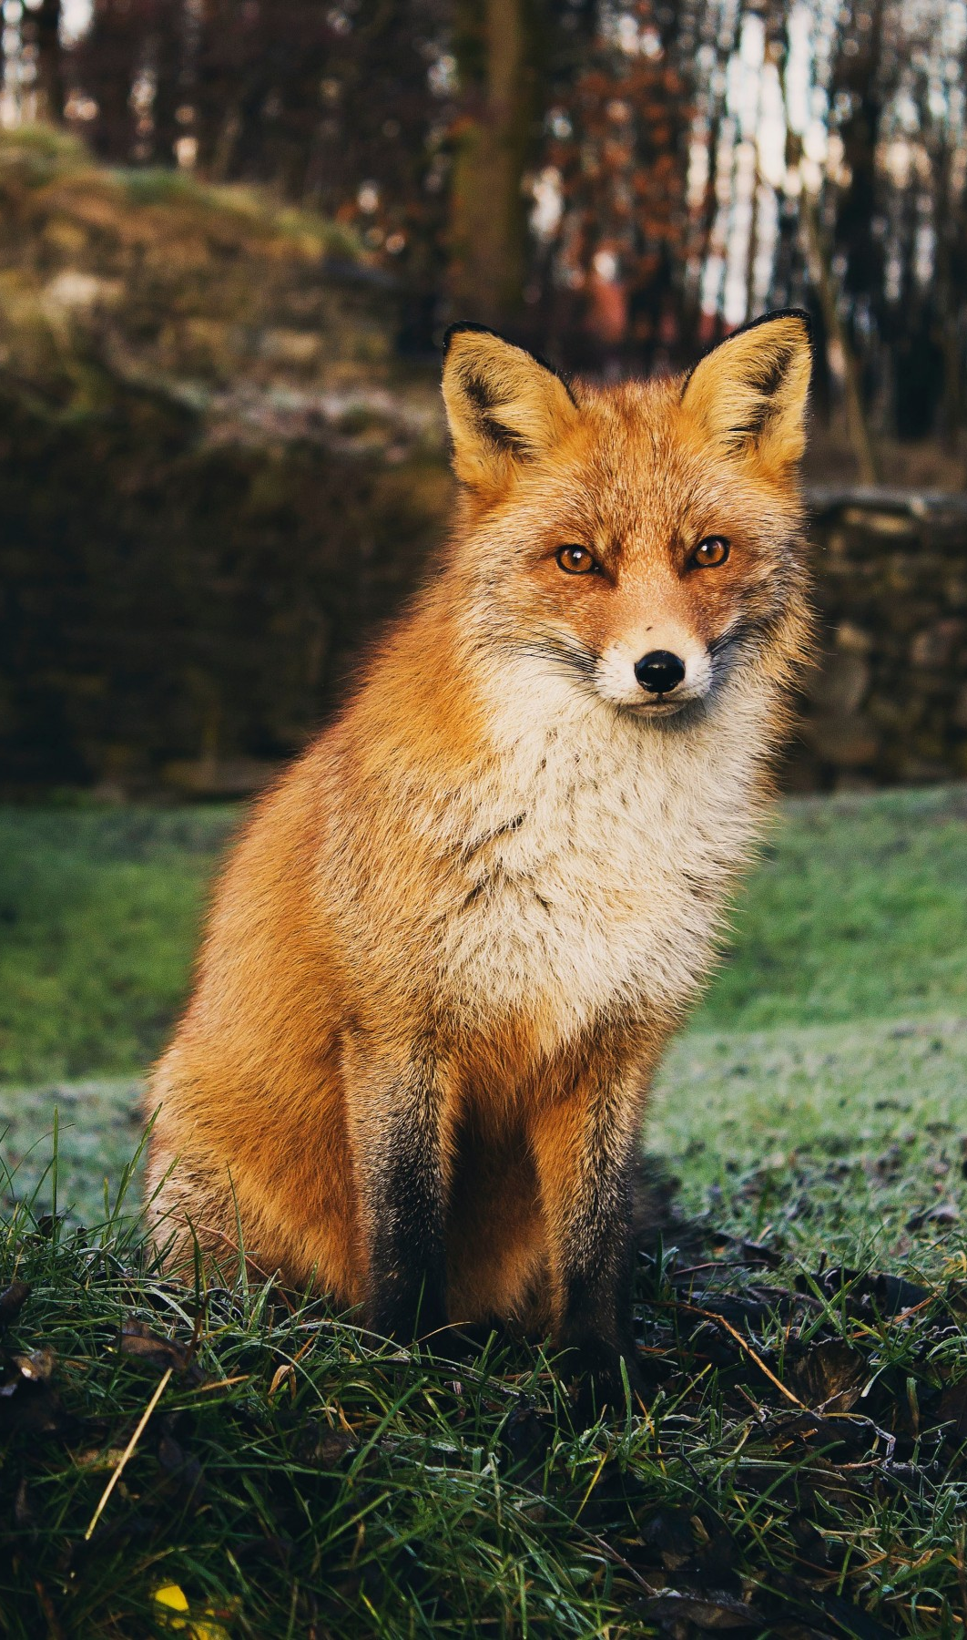
Phoebe
Phoebe the Fox is devilish, a bit messy and always up for an adventure. She’s a country girl who knows every brook, field and grove in the county. Days are spent hunting rodents with Owleanor and life is pretty good. As long as she can keep Owleanor safe from Old Man Wetherby and that Dog, both of whom are set on killing Owleanor.
Possible voices: Nicole Kidman, Emily Blunt, Thandie Newton

Slide 9
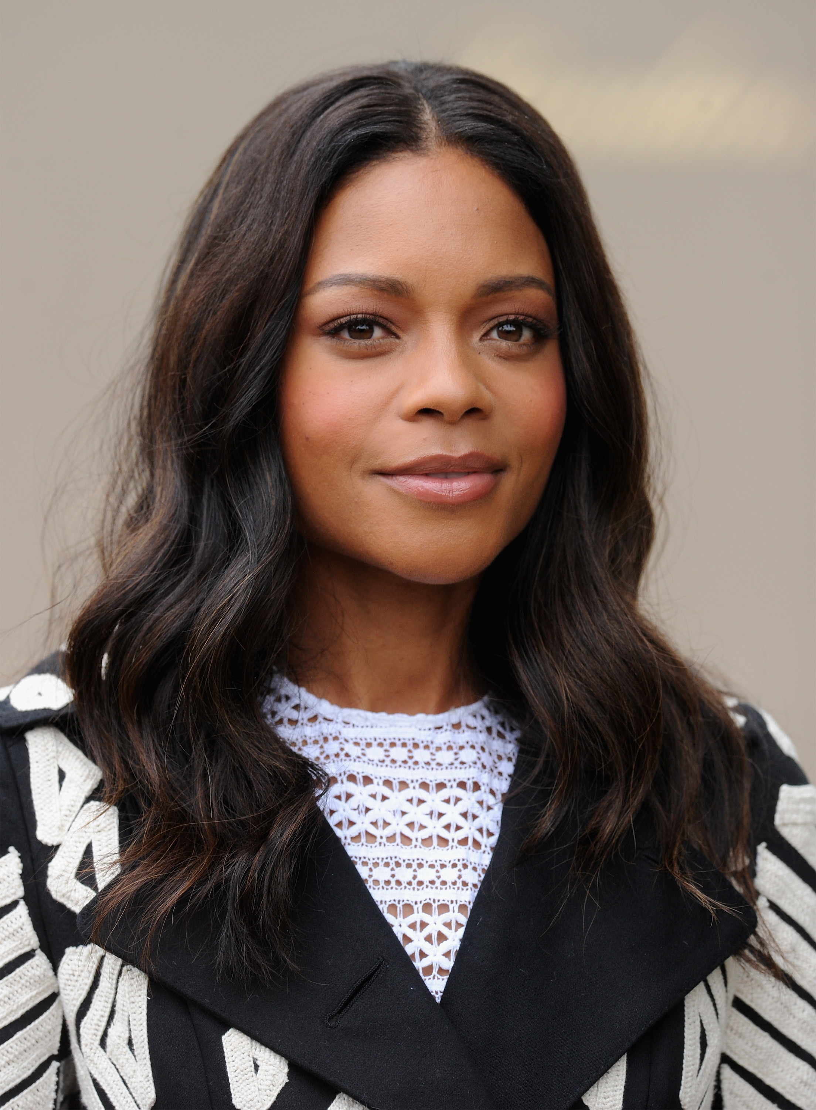
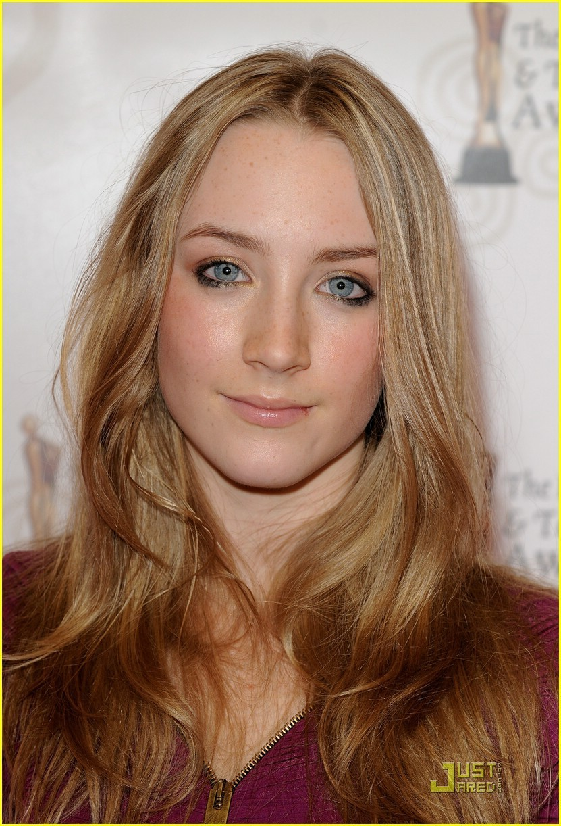
Agnes & Elsie
Agnes is happy to serve her country during a time of war but being able to race through the deserted streets of London at breakneck speed is the biggest bonus possible for this speed addict. Pedal to the metal!
Elsie understands animals. And prefers them to humans. But her country needs her so she volunteered to help the humans…but is really hoping to get back to the animals.

Slide 10
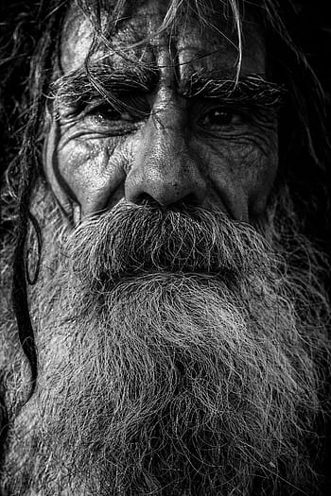
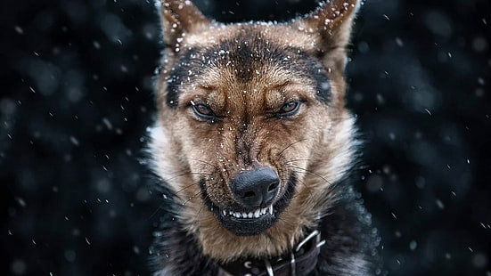
Old Man Wetherby & Dog
Duncan Wetherby doesn’t like you. Don’t take it personally, he doesn’t like anyone. But he really HATES Owleanor. He wants that owl dead, stuffed and on his mantle. And he’ll hunt her as far as it takes to make that happen.
Dog hates Fox. Dog hates Owl. Dog will have his revenge.

Slide 11
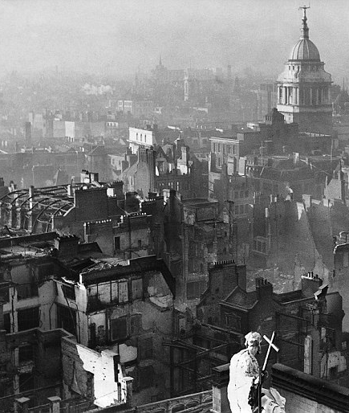
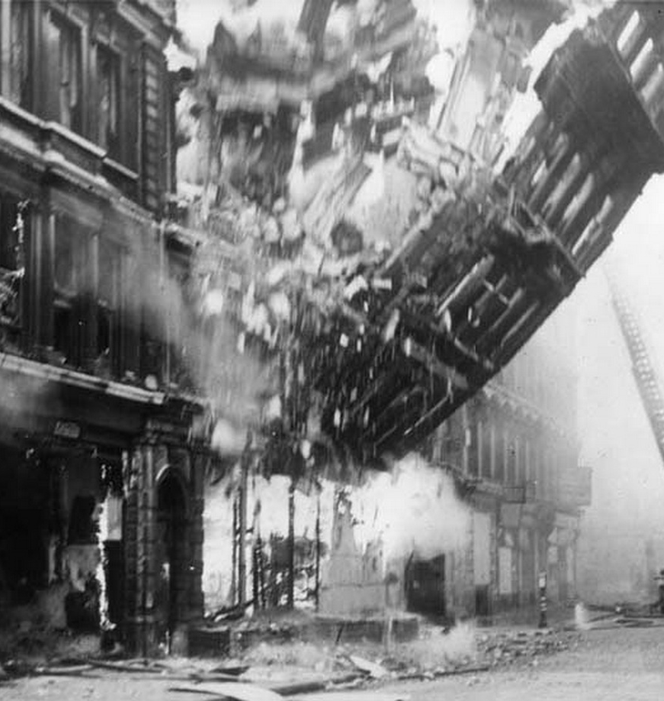

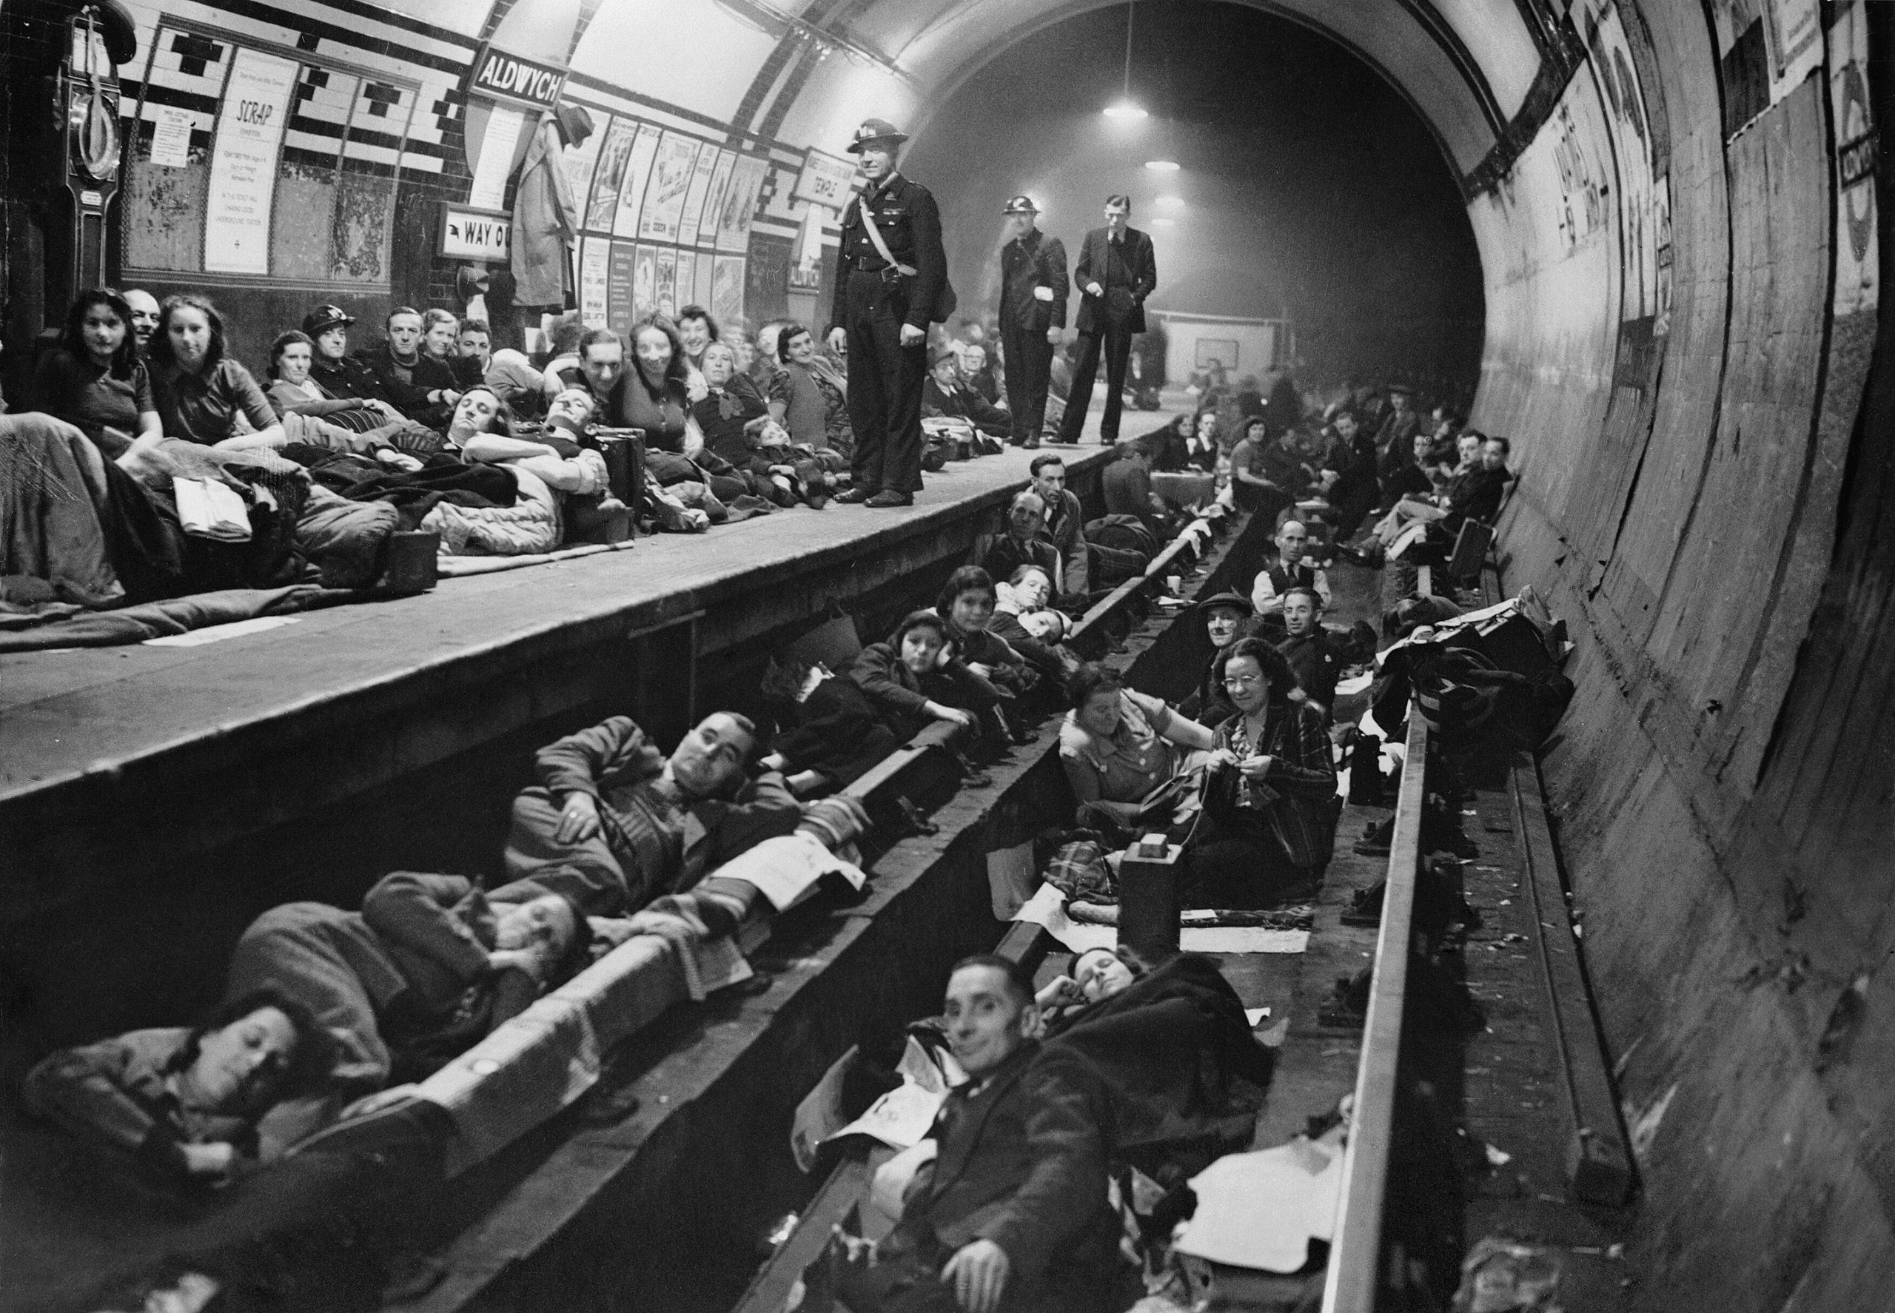
LONDON DURING THE BLITZ
8 months 5 days of bombing by Germany (September 7, 1940 – May 11, 1941)
43,000 killed
Up to 139,000 injured
2 million homes damaged or destroyed, 60% in London
1 in 6 Londoners was homeless at some point during the Blitz

Slide 12
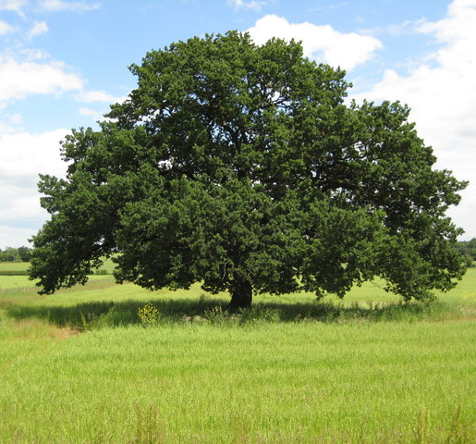
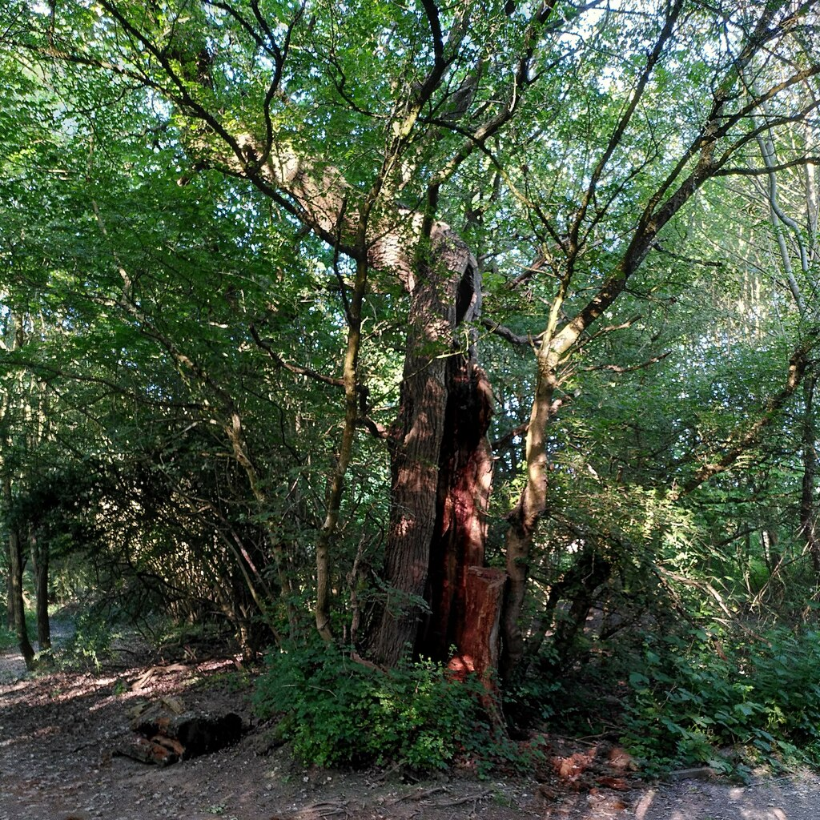

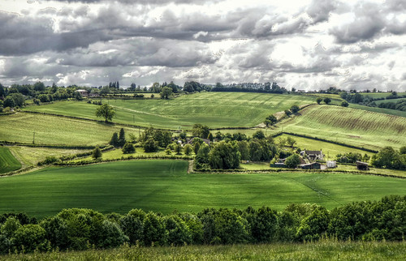
ENGLISH COUNTRYSIDE
For a cat whose whole world consists of a flat in London and a bustling hospital, the English countryside might has well be the jungles of the Amazon. With expansive fields, meandering rivers, thickets, massive trees, Farmers with shotguns, angry dogs and furry & feathered creatures never seen before, the English countryside holds dangers and blessings Cyd never experienced.
This Photo by Unknown Author is licensed under CC BY-SA
This Photo by Unknown Author is licensed under CC BY-SA
This Photo by Unknown Author is licensed under CC BY-NC-ND
This Photo by Unknown Author is licensed under CC BY

Slide 13
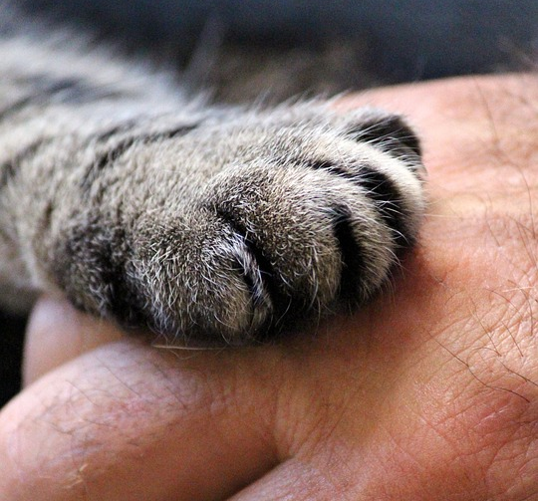

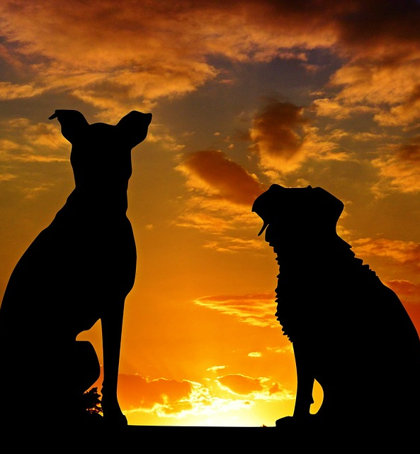
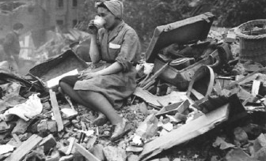
THEMES
The value and depth of love in relationships between animals and people
Friendships between animals
Friendships between people
Resilience in time of war and chaos
Intergenerational friendships

Slide 14

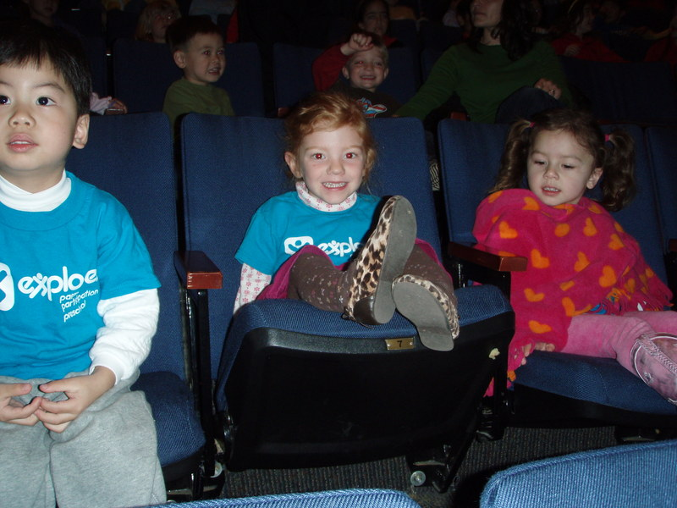


AUDIENCE
Who wouldn’t love Cyd & Julie? This story appeals to anyone whose loved/loves a furbaby, anyone whose had a great friendship that persevered during tough times and anyone whose seen unlikely friendships happen between animals!
Cyd & Julie has mass appeal across all demographics!
This Photo by Unknown Author is licensed under CC BY-NC-ND
This Photo by Unknown Author is licensed under CC BY-NC-ND

Slide 15



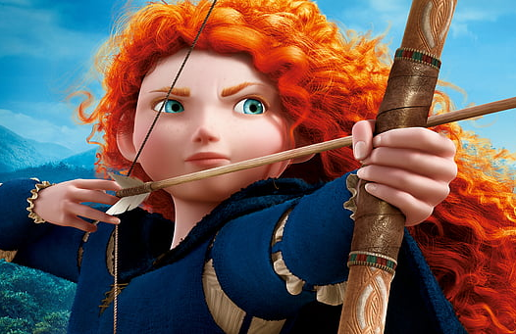
Market Potential
Animated films with female lead:
Frozen: $1.3 billion, Frozen 2: $1.45 billion
Moana: $643 million, Moana 2: $900 million
Inside Out: $859 million, Inside Out 2: $1.7 billion
Brave: $538 million
This Photo by Unknown Author is licensed under CC BY

Slide 16
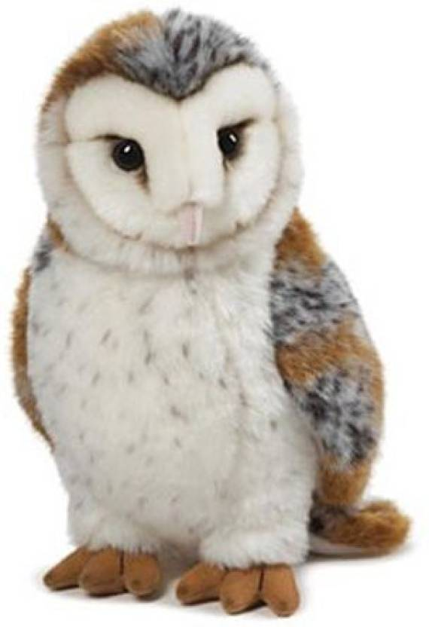
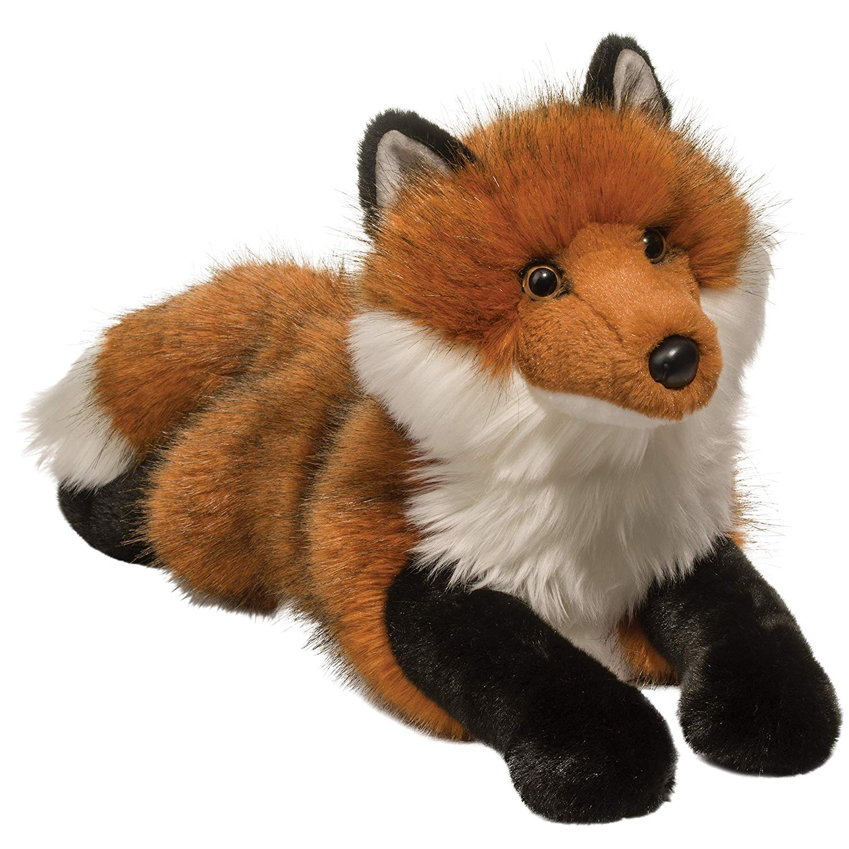
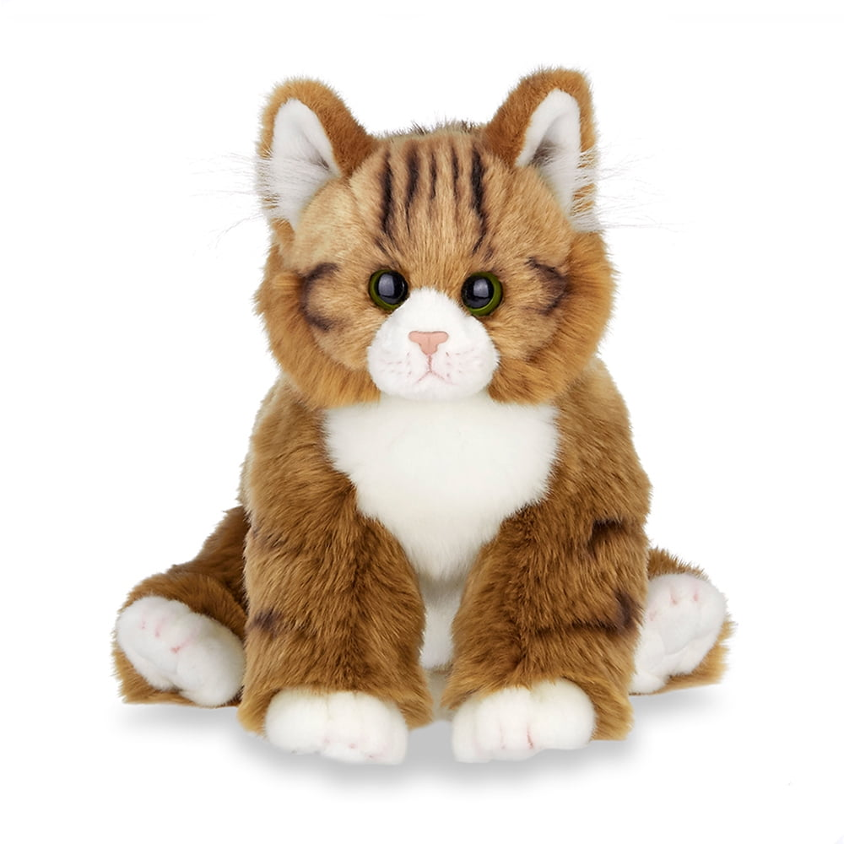
MERCHANDISING POTENTIAL
Retail merchandise revenue from animated films:
Frozen: $5.3 billion
Minions: $2.5 billion
Toy Story: $10 billion
Cars: $8 billion

Slide 17
BRIDGET GIBSON
Bridget Gibson was born and raised in the San Francisco Bay Area. She took her first film class in the 8th grade and has been enamored ever since. A graduate of SFSU film school, she has worked in the unscripted and podcast fields of the entertainment industry. She made Top Ten in Scriptapalooza International Screenwriting Competition out of 4,400 entrants in 2013 with her script “Family Gatherings”. Bridget wrote “Cyd & Julie” as a love letter to her beloved cat, Cyd (2003-2018), and to all the humans who have had loving heart & soul connections to furbabies (and featherbabies and finbabies). She currently lives in Los Angeles.

